Slide 1




2021
REGENERATION CONSULTANTS
Predicting the City-Cycle Fuel Consumption in Miles per Gallon of a Car

Slide 2

AGENDA
INTRODUCTION
OPERATION: NEW FLEET
FUEL CONSUMPTION
PROOF OF CONCEPT
BENEFITS
Conclusions
QUESTIONS

Slide 3
AGENDA
INTRODUCTION

Slide 4


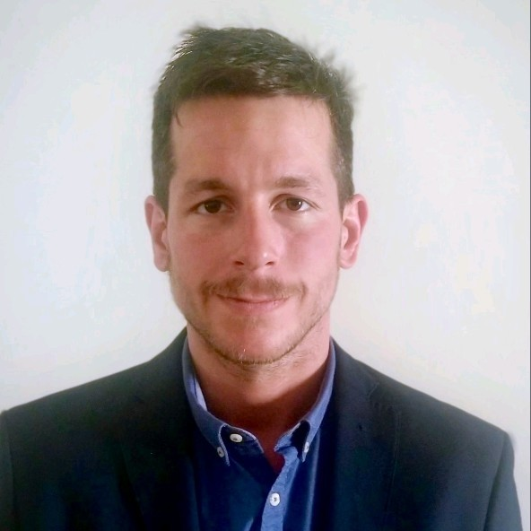
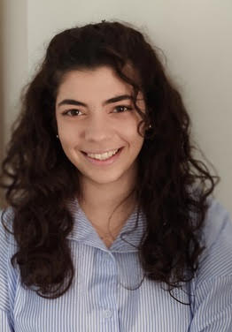

OUR TEAM
Regeneration Consultants → Greek consultancy company specialized in many domains
For this project → Department of Data Science and ML
Konstantinos Aggelopoulos
Nikolaos
Vanas
Efthymios
Zetos
Antonia
Fatsea
Panagiotis
Karatakis
Contact Us:
Tel +30210xxxxxxx
Email rentcar@recon.com

Slide 5
AGENDA
OPERATION: NEW FLEET

Slide 6
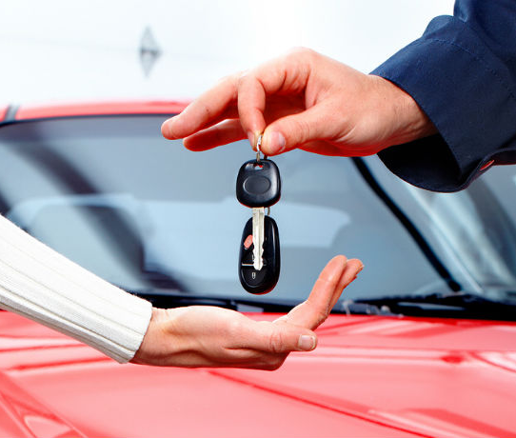
OPERATION: NEW FLEET
According to big companies annual reports ( Hertz ,Avis etc )
  Car fleet is roughly changing by 92%
  Cars are replaced on 32.5 K miles on average
Many factors to take into account
We will focus on fuel consumption of the cars

Slide 7
AGENDA
FUEL CONSUMPTION

Slide 8
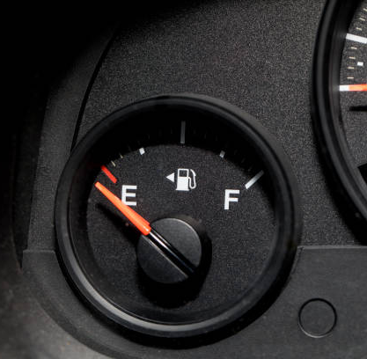
FUEL CONSUMPTION
Varies from car to car
One of the basic car expenses
Transport fuels produce CO2 emissions

Slide 9

According to a study conducted by market research firm Kelton Global for the American Chemistry Council
Americans rank fuel efficiency as the MOST important factor in their decision to purchase a vehicle.

Slide 10
Big fuel expenses →
Unhappy customers

Slide 11

Carbon Dioxide Emissions
Based on ourworldindata.org

Slide 12
Environmental Protection Agency of USA
“Every gallon of gasoline burned creates about 8887 grams of CO2’’

Slide 13
AGENDA
BENEFITS

Slide 14

BENEFITS OF LOW FUEL CONSUMPTION
Re- fueling after more miles → Lower customer fuel costs
Reduction of CO2 emissions → Environmental Sustainability

Slide 15
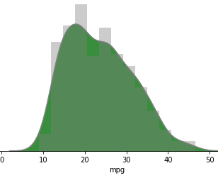
CURRENT SITUATION
Average mpg comes to 23.5
23.5 mpg equals to 10 L / 100 km
CO2 emissions up to 23.47 kg/100 km
Selection Area
Based on dataset provided by Airbnb

Slide 16
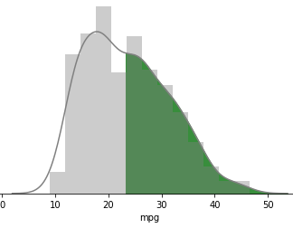
The Solution
Selection ONLY above the median of 23 mpg
Your new fleet average mpg → 30.32
30.32 mpg → 7.76 L/100 km
CO2 emissions up to 18.20 kg/100 km
Selection Area

Slide 17
Comparison of Current , 50% and 75%

Slide 18
AS A RESULT
Select over 50%
Reduction of customer’s fuel expenses by 22.4%
Reduction of CO2 emissions also by 22.4%
Select over 75%
Reduction of customer’s fuel expenses by 31.6%
Reduction of CO2 emissions also by 31.6%

Slide 19
AGENDA
PROOF OF CONCEPT

Slide 20
The Dataset
Quantity of Cars: | 398
Number of Attributes: | 8
Target: | Miles per gallon
Attributes
Cylinders
Displayments
Horsepower
Weight
Acceleration
Model Year
Origin
Car name
Provided by Airbnb

Slide 21

Exploratory Data Analysis
Inspect for missing values, outliers
Study distributions of the data
Study correlations of the data
Power BI Overview

Slide 22
Preprocessing
Used regression model to fill horsepower missing values
Drop cars with missing mile per gallons
One-hot encoding for origin, cylinders
Extract brands out of car names
Grouping cars into 2 clusters

Slide 23
SPLITTING THE DATASET
Train Set
70%
Cleaned Data
Cross Validation
30%
Test Set

Slide 24
MODELS EXPLORATION
Regression Models | Train Rsquared | Test RSquared | Train MSE | Test MSE | Overfitting ?
Linear Regressor | 0.82 | 0.81 | 10.36 | 11.59 | NO
Random Forest | 0.98 | 0.86 | 1.09 | 8.6 | YES
Extra Trees | 1 | 0.86 | 0 | 8.19 | YES
Voting Regressor (SVR, Linear) | 0.86 | 0.84 | 7.85 | 9.65 | NO
SVR | 0.91 | 0.86 | 5.22 | 8.31 | YES
Decision Tree | 1 | 0.77 | 0 | 14.11 | YES
Gradient Boosting | 0.94 | 0.75 | 5.02 | 9.66 | YES

Slide 25

STEP BY STEP
Voting Regressor
Xtrain
ytrain
Scaling
Xtrain/sc
ytrain/sc
Linear
Y1
Scaler invert
X
y
SVR
Y2
ypredict/sc
ypredict
SVR (Linear)
Y3
compare
Xtest
ytest
Scaling X
Xtest/sc
ytest
ytest

Slide 26
AGENDA
Conclusions

Slide 27
In conclusion thanks to our product
Fuel consumption will turn into a critical factor during fleet renewal
Low fuel consumption will offer satisfaction to customers, who will multiply
Production of less CO2 emissions, improving and proving user’s environmental consciousness
Visualization of fleet attributes at any time

Slide 28
AGENDA
QUESTIONS

Slide 29


ANY QUESTIONS?
For more details feel free to visit our portfolio https://github.com/regeneration-team-3/Project-Team-3

